Slide 1
T08 - Practicum Project
360 Proximity Detector
Presentation by Matt Whiteside, Jared Rue
Naser Alshami and Timothy Nelson

Slide 2
Problem
RC cars are difficult to drive without colliding into objects
Limited visibility of RC car, especially at a distance, contributes to this problem
RC cars might damage objects be damaged by collisions

Slide 3
Motivation
Giving feedback to user can prevent collisions
Reduced collisions can prevent damage to RC car or other objects
By preventing collisions, user will have a more enjoyable experience

Slide 4
Objective
Create a prototype that can detect objects near the RC car and alert the user so that they can correct their driving.

Slide 5
Alternatives
No commercial product satisfies this problem
There are many DIY projects that are similar but serve a different purpose

Slide 6
Requirements
Detect objects up to 80cm away
When object is detected, will notify user through visual and audio stimulus
Must detect 360 degrees around RC car
Link to PDS for complete document

Slide 7
Schedule
Never fell behind schedule
Link TBD for Naser

Slide 8
Approach
Targeted Inexpensive modules
The simpler the better
Used iterative approach to implementing features in order of importance

Slide 9
Device Design
Decided on a single range sensor spinning on a servo
  Simple
  Cheap
  More effective at detection in every direction
Alternative would be multiple fixed sensors set radially around RC car
  Multiple IR sensors would cause project to be too expensive
  Would possibly be faster to detect objects

Slide 10
Microcontroller
Decided on Atmega328
  Supported by class
  Cheap
  Plenty of GPIOs, including analog

Slide 11
Rotation Actuator
Decided on parallax servo
  Easy PWM control
  180 RPM
  Self contained package
Alternative would be Motor
  Additional circuitry required for direction control

Slide 12
Audio Alert
Decided on CX-0905C Buzzer
  Powered by DC signal
  High dB for small package
  No PWM or additional components required
Alternative was speaker speaking words
  Complex
  Unnecessary for purpose of alerting user

Slide 13
LCD
Decided on NHD‐C0220BiZ‐FSW‐FBW‐3V3M
  Experience with use
  Compact design
Drawbacks
  Required logic level shifting circuitry
  Difficult to program

Slide 14
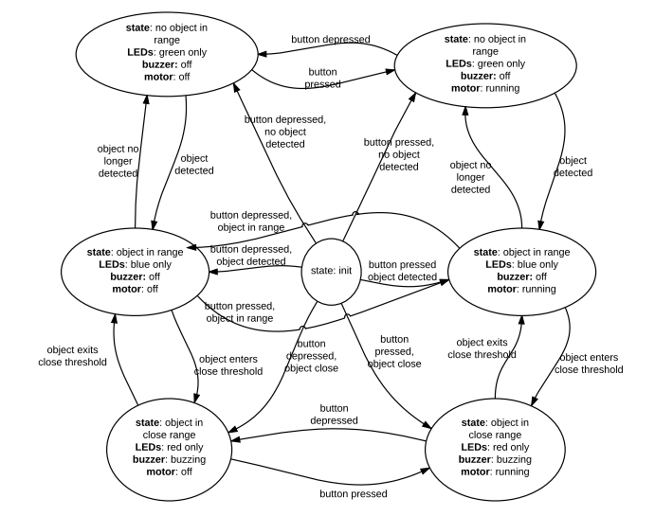
Software State Diagram

Slide 15
Algorithm
begin
initialize ADC
initialize PWM
initialize LEDs
initialize interrupt
interrupt checking for button press
if button press and PWM off
turn on rotating servo
if button press and PWM on
turn off rotating servo
loop
read analog input from IR proximity sensor
if input > near
light red LED and buzzer
else if input < near and input > far
light blue LED
else input < far
light green LED
loop forever
end

Slide 16
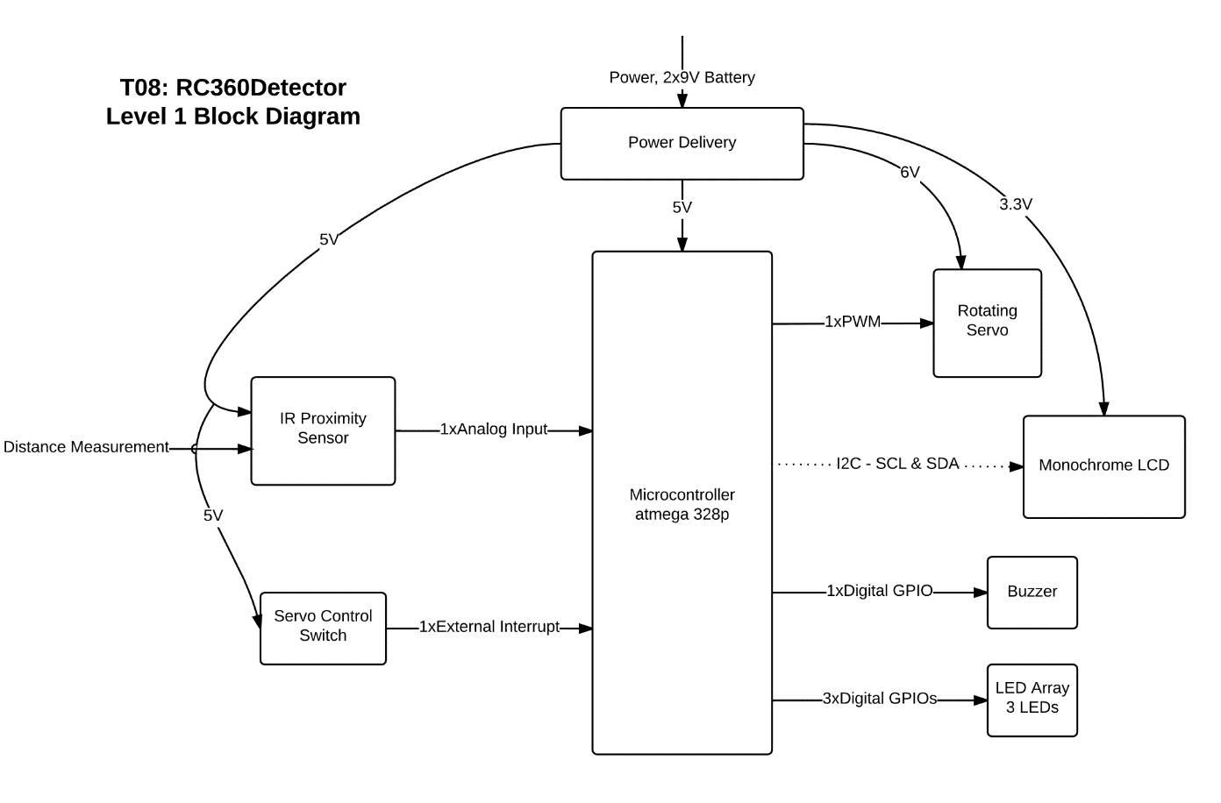
Module Decomposition

Slide 17
Implementation
Schematic
PCB
Main.c

Slide 18
IP and Prior Work
Started software off example code for programming ATmega328
  LED Example: http://www.micahcarrick.com/tutorials/avr-microcontroller-tutorial/getting-started.html
  PWM example: https://gist.github.com/Wollw/2425784
Current software under GPL v3 license

Slide 19
Testing
Motor start/stop button: Here
PCB: Here
Motor spinning performance/endurance: Here
Object detection: Here

Slide 20
Results
LCD program was too complex to implement in time
Button issues for servo control. Edge trigger vs state hold.
Product works and meets most specifications

Slide 21
Contributions
Timothy Nelson: Sch, PCB, box, solder assembly, assignments
Naser Alshami: Schedule, RC car mount, assignments
Matt Whiteside: Coding, assignments
Jared Rue: Sch, PCB, solder, coding, assignments

Slide 22
Lessons Learned
Learning to program the ATmega was probably the most substantive takeaway
A good team makes everything easier
The devil is in the details

